Slide 1
Software Requirements Specification
Project: CloudPi
CLOUD BASED STORAGE PLATFORM USING RASPBERRY PI
TEAM NO 15: A ANAS
ASWATHY KRISHNAN
JAYALEKSHMI K S
NANDHAKUMAR

Slide 2
CONTENTS
Problem statement
Objectives
Literature review
Survey stakeholders analysis
Motivation
Assumptions
Dependencies
Technical Requirements
Functional Requirements
Non functional requirements
Project plan
Challenges

Slide 3
PROBLEM STATEMENT
Problem or challenge
Users may be concerned about the security and privacy of their files when using third-party storage solutions. Moreover remote access and sharing is needed for them.
The context
Users finds it very difficult to trust their confidential data with a third party cloud
The impact
A huge risk of data breaches and cyber security issues

Slide 4
PROBLEM STATEMENT
The proposed solution:
The proposed solution is to create a web-based platform, Cloud Pi, that allows users to store, access, and manage their files securely and efficiently on a Raspberry Pi device remotely connected.
The expected outcome:
A functional web application that allows users to upload files and have them automatically transferred to a remote Raspberry Pi storage device using a Python script.

Slide 5
OBJECTIVES
File storage and sharing
Remote access and control
Security (encryption)
Web application development
Raspberry Pi integration
User authentication and authorization

Slide 6
LITERATURE REVIEW
Research Paper | Inference
Preventing Pollution Attacks in Cloud Storages, Aswin Viswas V, Philip Samuel, 2018 | Utilizing remote storage to store information has numerous advantages including accessibility and operational costs. Although the security of such information is still one of the major concerns for the clients.
Secure distributed adaptive bin packing algorithm for cloud storage Irfan Mohiuddin, Ahmad Almogren, Mohammed Al Qurishi, Mohammad Mehedi Hassan, Giancarlo Fortino, Iehab Al Rassan 2018 | Provides highly scalable and flexible computing and storage resources through a pay-as-you-go strategy. They are becoming more and more popular, and many companies are now moving their data from internal data centers to cloud storage providers. The ever-growing user base and storage space for remote data management will bring problems such as low resource efficiency and internal threats to static data in cloud storage.
An integrity verification scheme of cloud storage for internet-of-things mobile terminal devices , Xiuqing Lu, Zhenkuan Pan, Hequn Xian,2019. | Since mobile cloud computing has many advantages, such as mass storage, low cost, and scalability, most data owners store their data on cloud servers to share It exposes you to many security issues, such as data integrity. More and more test programs have been proposed to verify the integrity of the data

Slide 7
STAKEHOLDERS
If our cloud based storage using Raspberry Pi were to be launched out in the software market, the potential stakeholders would be :
Customers
Software Professionals
Professors
Accounting Staff
Medical, etc
Employees
Individuals working for a company who help the market and support the company
Competitors
Other companies offering similar cloud storage solutions - NextCloud, Sync.com etc.

Slide 8
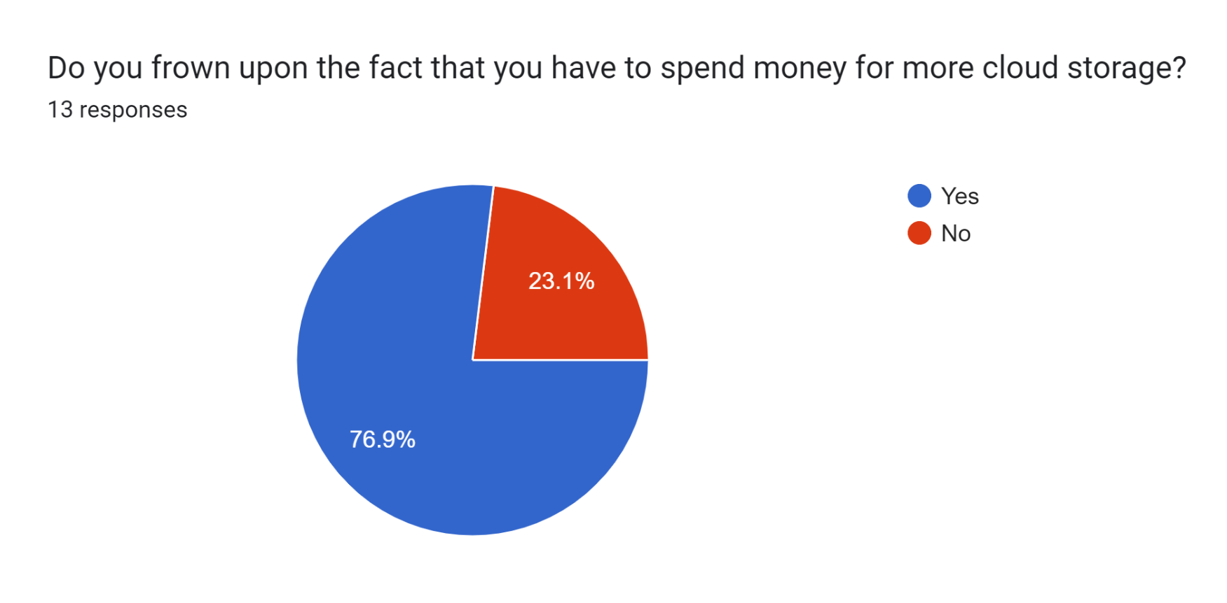
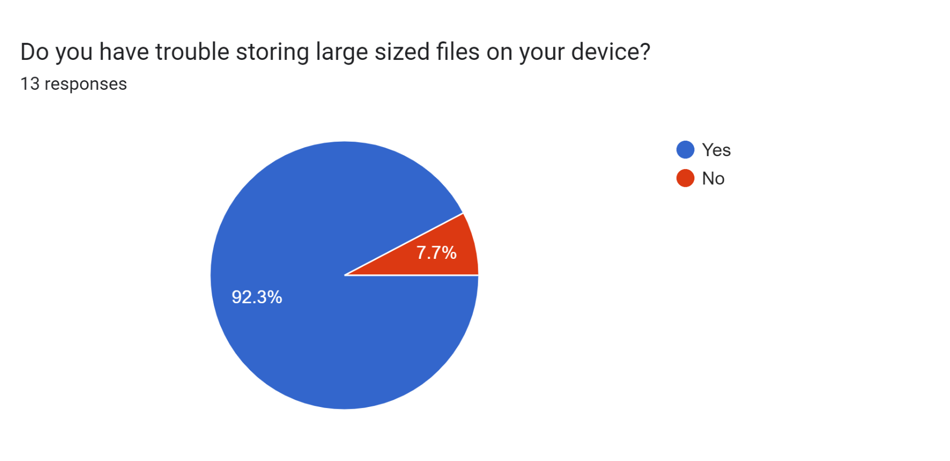
SURVEY STAKEHOLDER ANALYSIS
This is a survey conducted by our group to get to know what users prefer in terms of file storage.

Slide 9
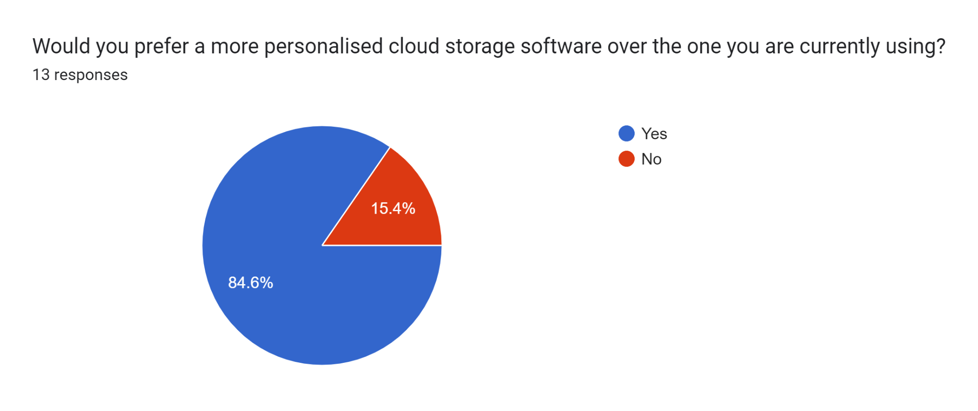
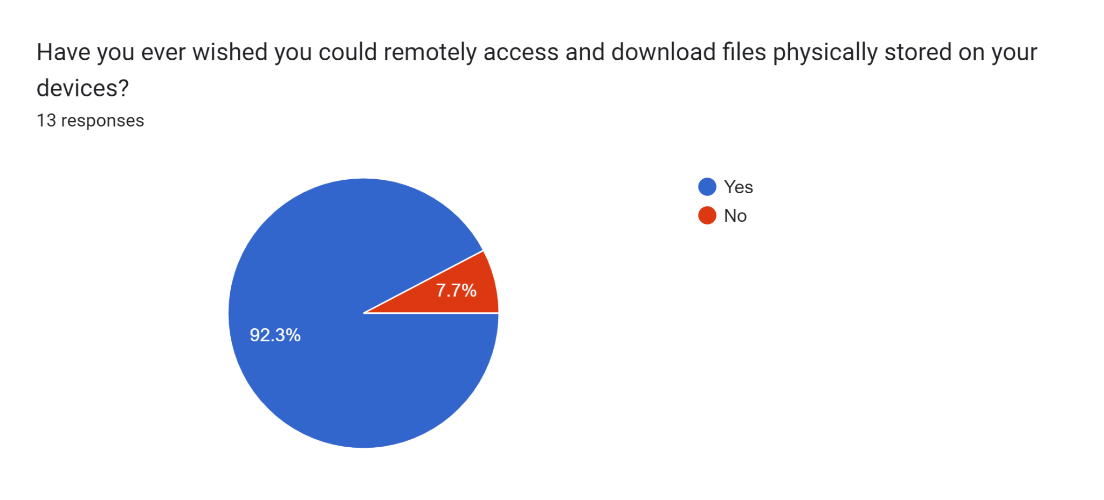
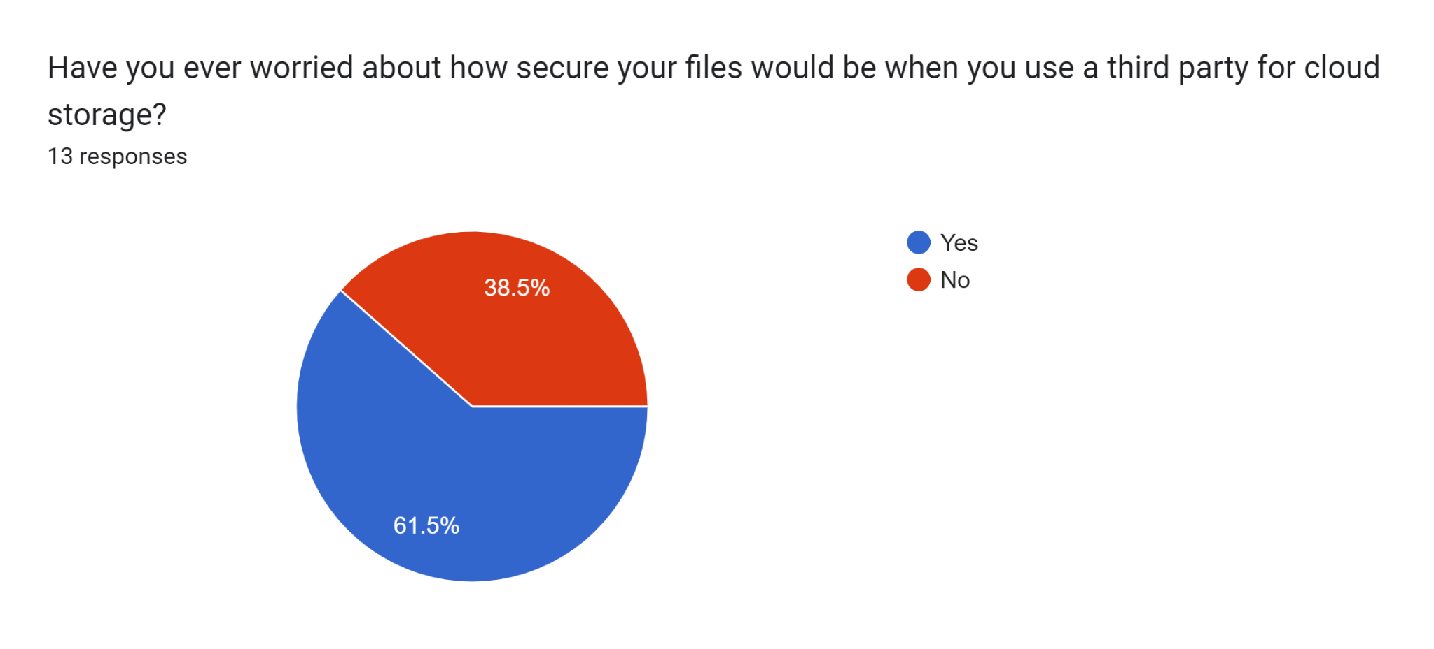

Slide 10
MOTIVATION
Increasing demand for file sharing and collaboration in remote work environments.
Providing a secure and reliable platform for file sharing and storage.
The need for a cost-effective and scalable solution for storing and managing files.
The opportunity to develop skills in web development, cloud computing, and network security.

Slide 11
ASSUMPTIONS
Users have access to a web browser and an internet connection to use the application.
Users have basic knowledge of how to upload and delete files.
The remote storage system is available and accessible to the application.
The Raspberry Pi is properly set up and configured to receive and process the uploaded files.
The uploaded files will not exceed the available storage capacity of the remote storage system or the Raspberry Pi.

Slide 12
DEPENDENCIES
The application relies on the Django web framework and its built-in functionality for handling file uploads and forms.
The Raspberry Pi must have the necessary software and libraries installed to process the uploaded files.
The application may depend on third-party packages or modules for specific features or functionality.

Slide 13
TECHNICAL REQUIREMENTS
Django framework
Raspberry Pi with Raspbian OS
Internet connection with sufficient bandwidth to handle file transfers
Web server (e.g., Apache, Nginx) to serve Django web application
Access control mechanisms to secure file uploads and downloads

Slide 14
FUNCTIONAL REQUIREMENTS
User registration and login | he system should allow users to create an account, log in, and log out of the system.
File upload | Users should be able to upload files to the system, including specifying a name and description for each file.
File retrieval | Users should be able to view and download files that they have previously uploaded.
File deletion | Users should be able to delete files that they have previously uploaded.
Search | The system should allow users to search for files based on their name or description.

Slide 15
NON FUNCTIONAL REQUIREMENTS
Performance Requirements
File transfers should be fast and reliable, with minimal data loss or corruption.
The system, also Raspberry Pi, should be able to handle large files and file volumes without performance degradation.
Security
All user authentication should be done securely to prevent unauthorized access to the system.
Files and data should be encrypted for maximum security.

Slide 16
The system should be protected against malicious attacks and data breaches.
Safety Requirements:
Authentication : This requires implementing a user authentication system, such as a login page that prompts users to enter a username and password.
Authorisation
Encryption: Data stored on the Raspberry Pi should be encrypted to protect against unauthorized access or theft. This requires implementing encryption mechanisms.

Slide 17
SOFTWARE QUALITY ATTRIBUTES
Reliability
Security
Scalability
Usability
Performance
Compatibility
Maintainability
Portability

Slide 18
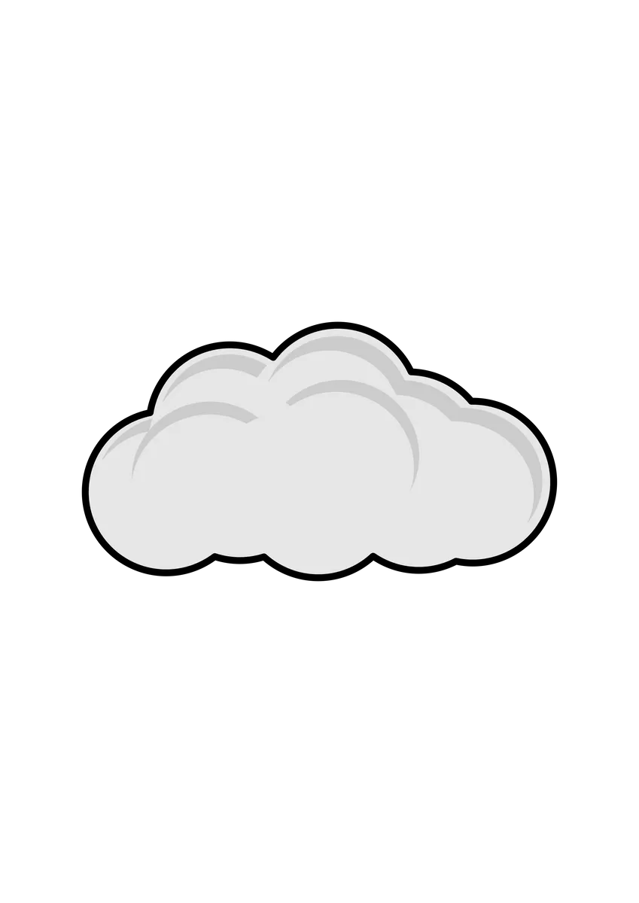
PROJECT PLAN
Research
Maintenance
Design
Deployment
Development
Testing

Slide 19
CHALLENGES
Performance : being a low cost single-board computer, it may not have the same performance capabilities as more powerful servers
Maintenance and support : we will need to provide ongoing maintenance and support to ensure that it remains functional and updated
Marketing and competition : we will need to develop effective marketing strategies to differentiate our solution from competitors in the market

